Slide 1
WHAM update

Slide 2
Beginning with Rec CPA, spring and fall VAST (Run 6 from last week’s presentation) and random effects (iid) for recruitment and survival….
Run 7: Transition age comps for all fleets from multinomial to logistic normal miss-0

Slide 3
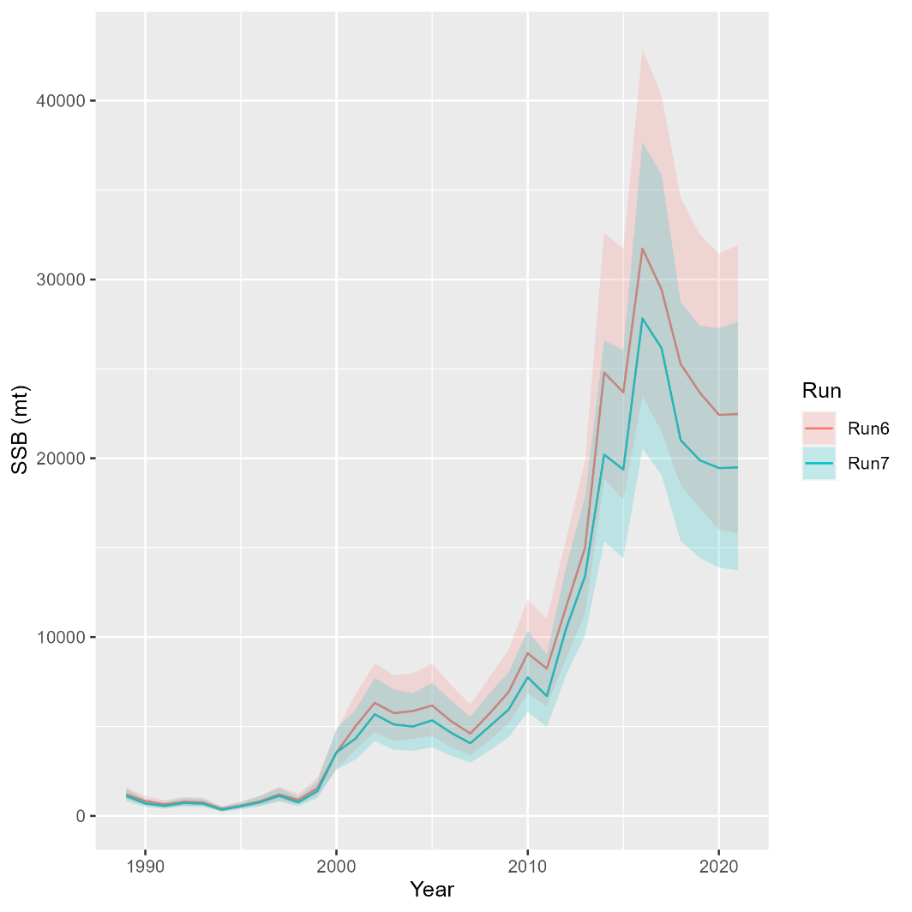
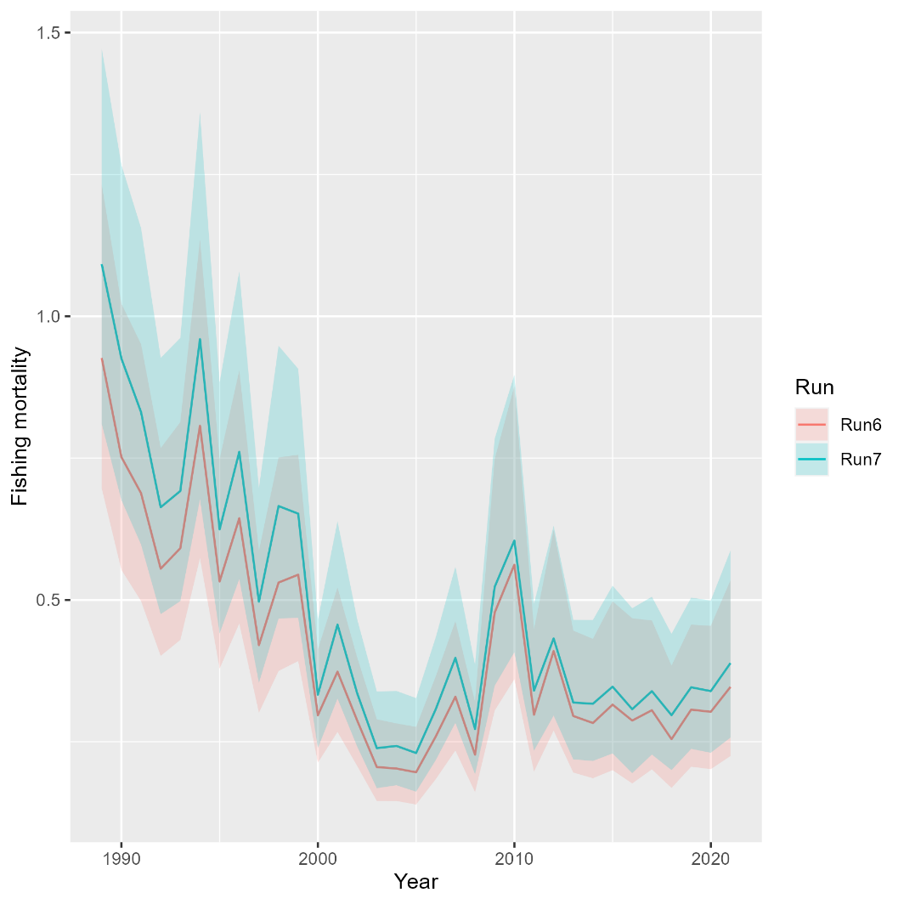
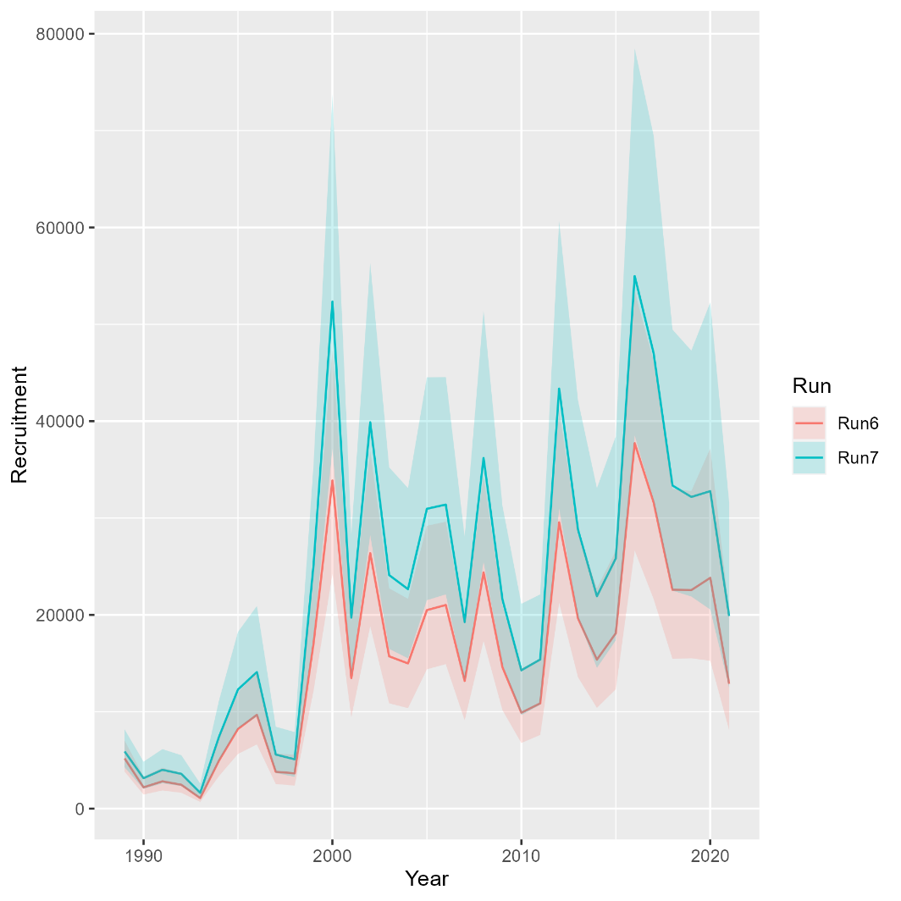
Run 7: Change in age composition distribution assumption
Mohn’s rho
 | Fmort | SSB | Rect
Run6 | 0.222 | -0.155 | -0.118
Run7 | 0.023 | -0.077 | 0.005
North

Slide 4
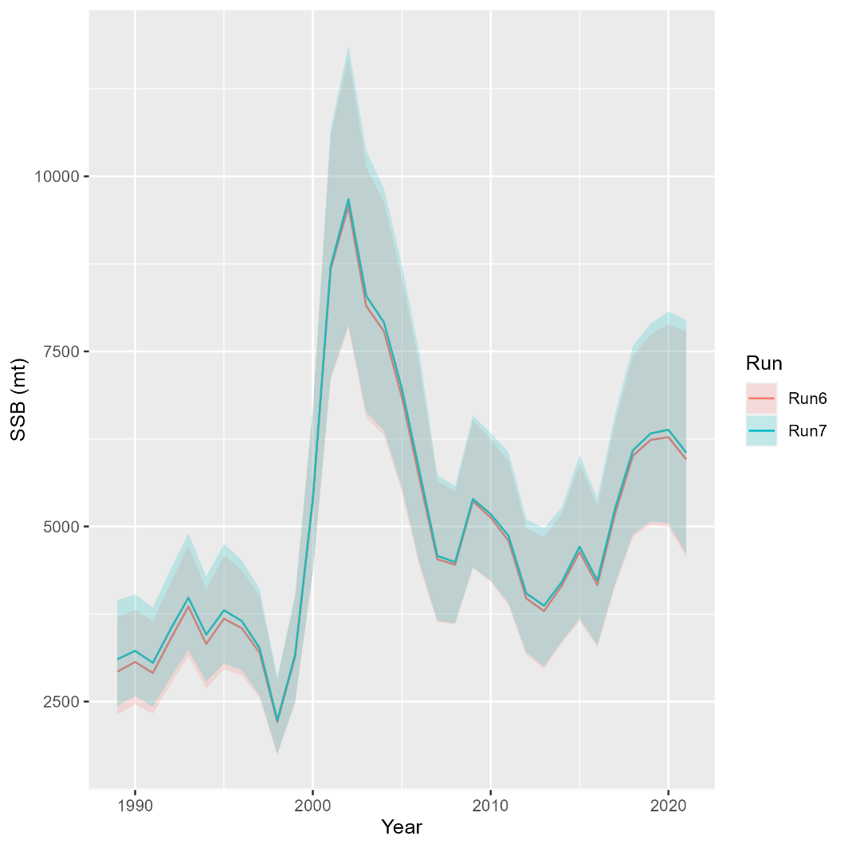
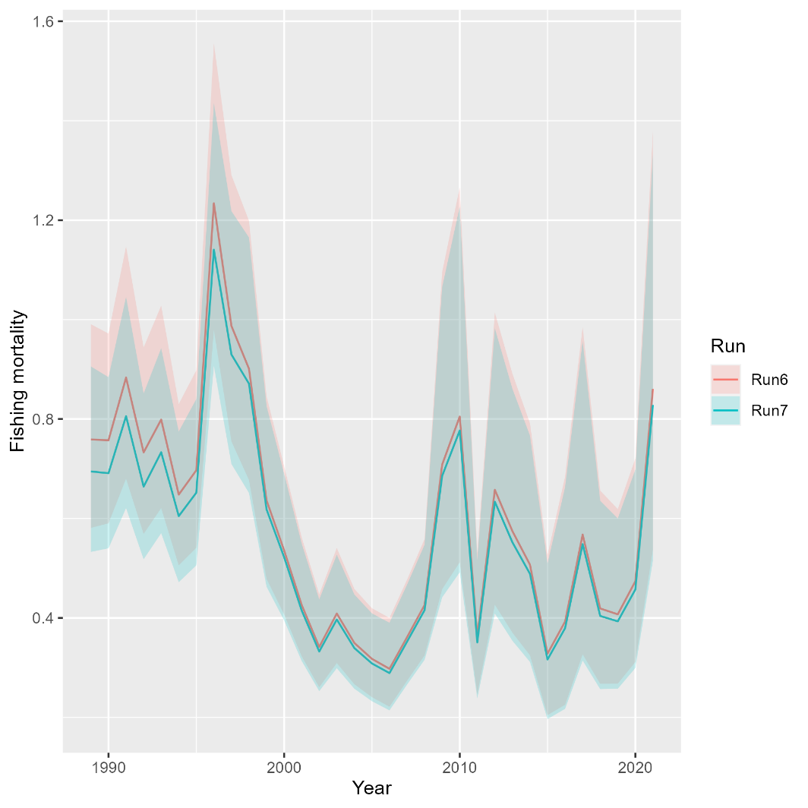
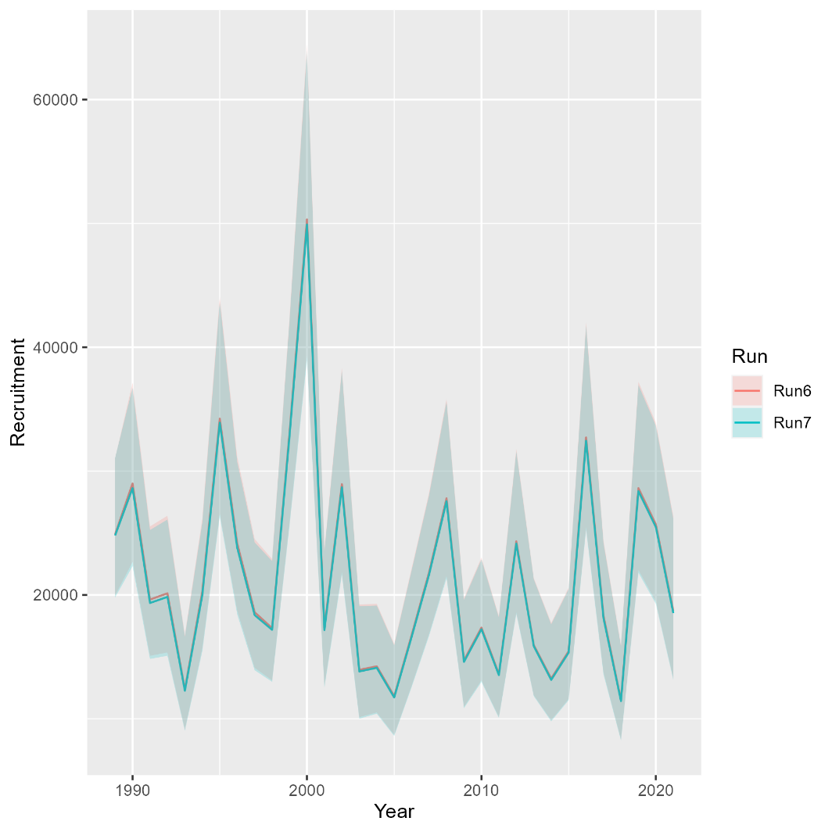
Run 7: Change in age composition distribution assumption
Mohn’s rho
 | Fmort | SSB | Rect
Run6 | 0.191 | -0.04 | 0.036
Run7 | 0.178 | -0.073 | 0.029
South

Slide 5
Beginning with Rec CPA, spring and fall VAST (Run 6 from last week’s presentation) and random effects (iid) for recruitment and survival….
Run 7: Transition age comps for all fleets from multinomial to logistic normal miss-0
Run 8: Movement during non-spawning seasons (N→S and S→N)
Fixed movement parameters at estimates from SS run
Needed to fix CVs for Rec CPA and sigma for North age 2+ survival at Run 7 values
Run 9: Movement priors with mean and sigma from SS
Needed to fix sigma for North age 2+ survival and Rec CPA and original (small) CV values
Run 10: Estimate AR1 time-varying movement; Did not converge

Slide 6
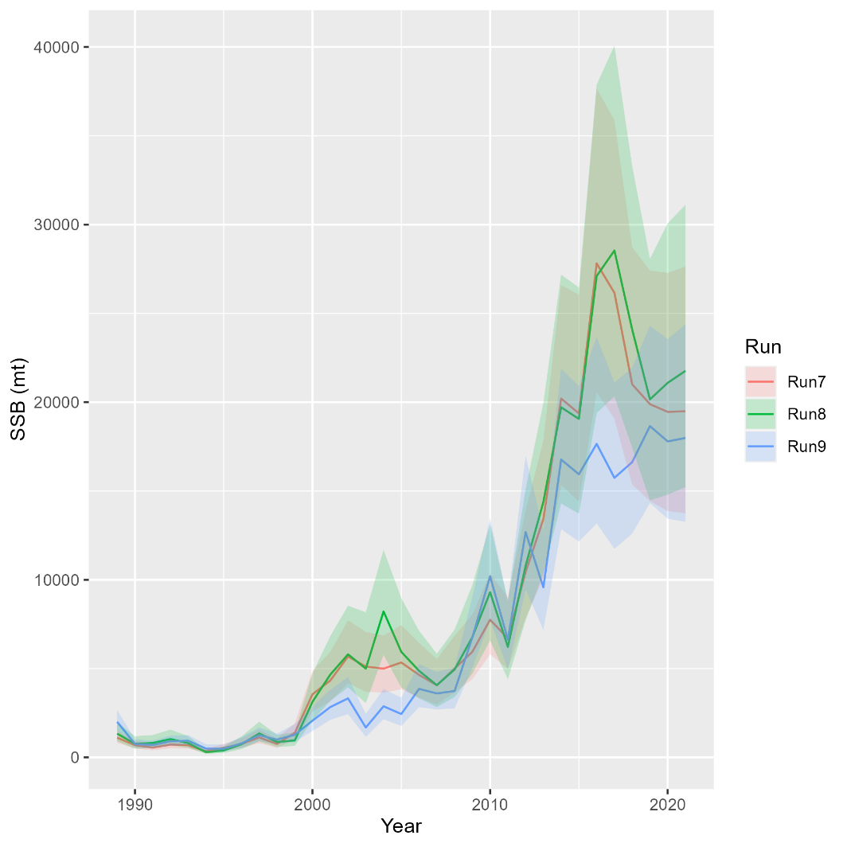
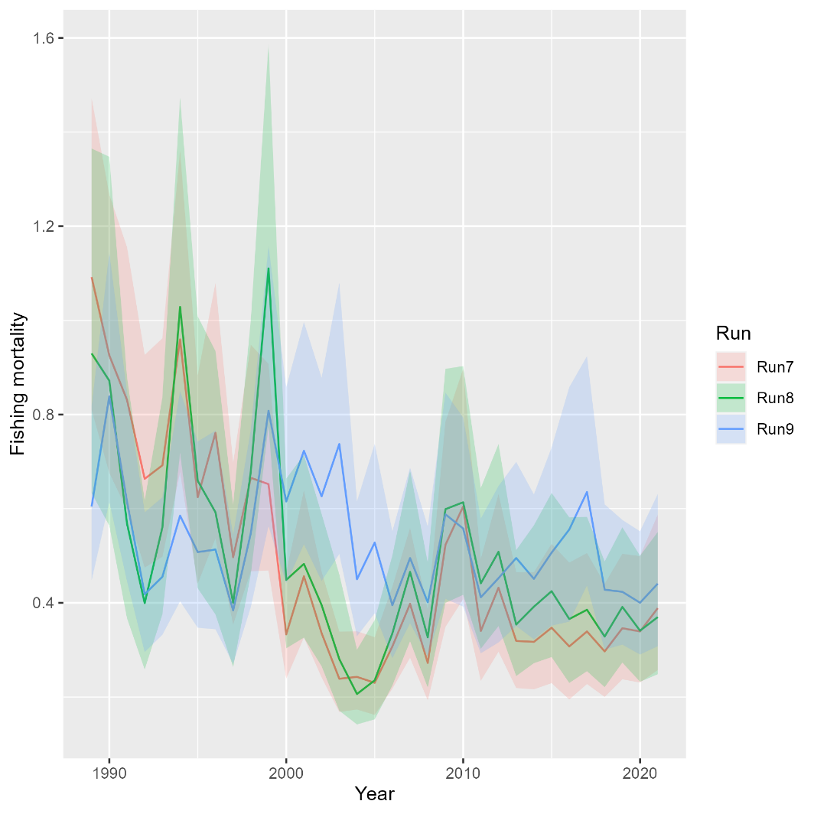
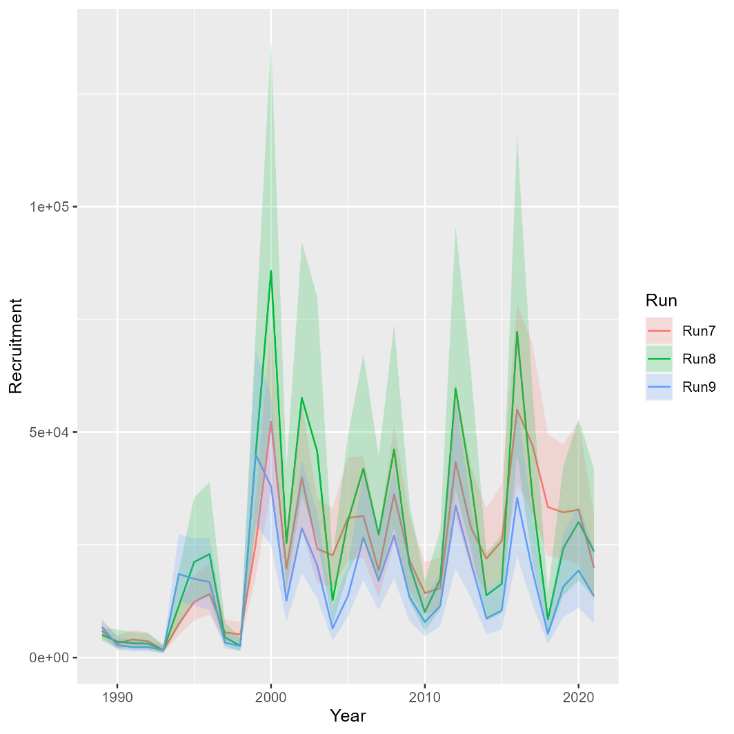
Runs 8-9: Exploring movement
Mohn’s rho
 | Fmort | SSB | Rect
Run7 | 0.023 | -0.077 | 0.005
Run8 | -0.012 | -0.028 | -0.029
Run9 | 0.015 | -0.054 | -0.026
North

Slide 7
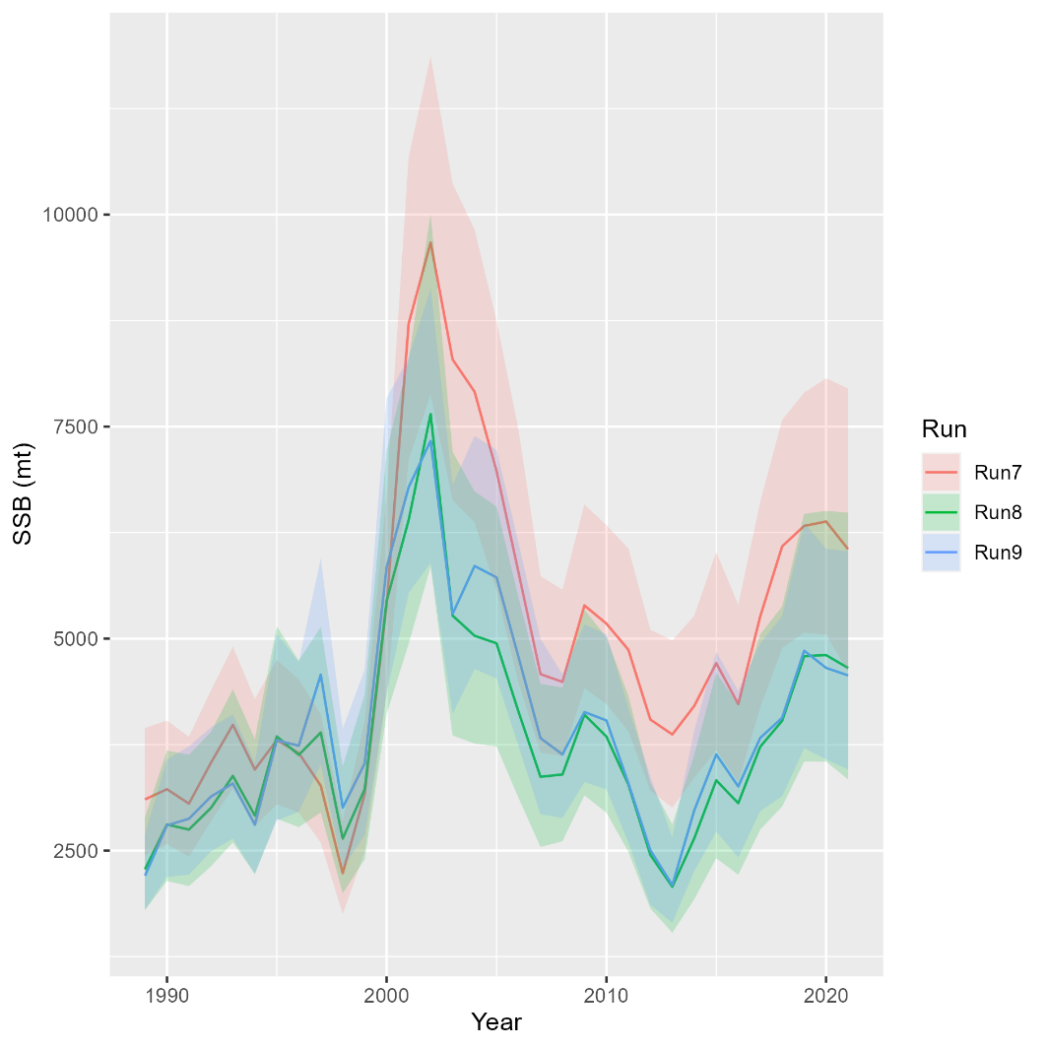
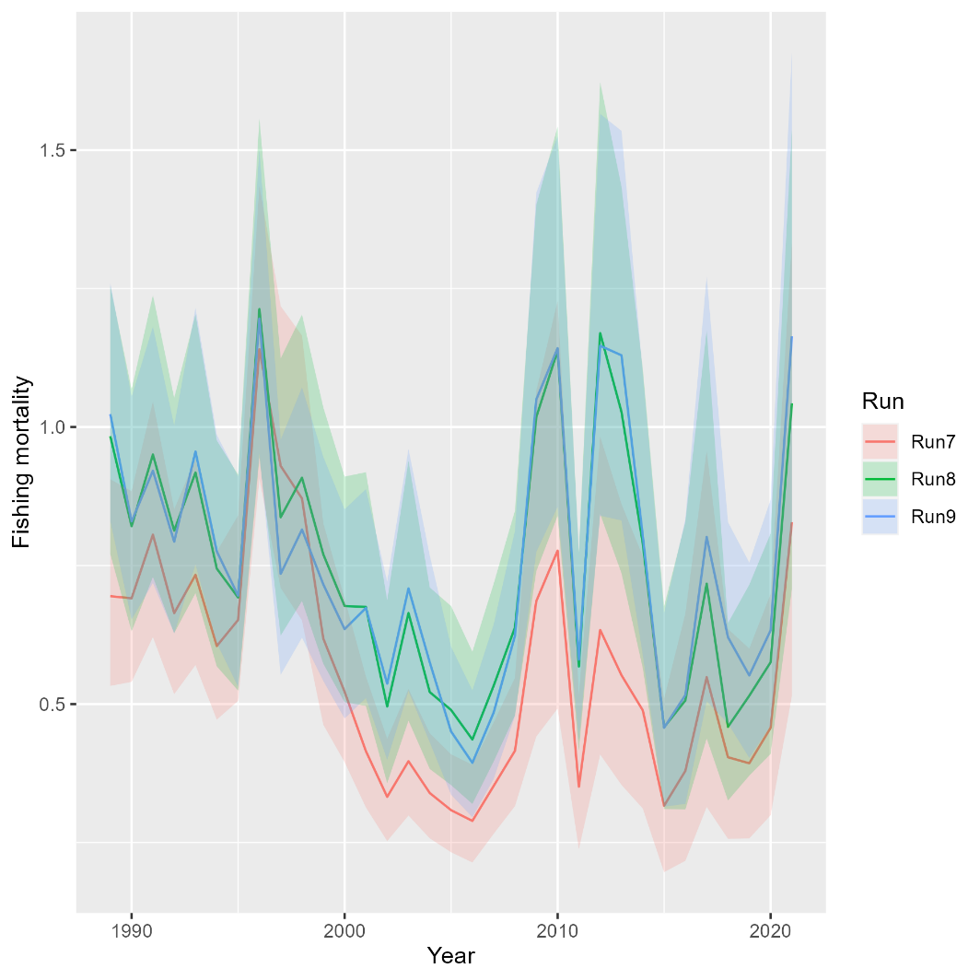
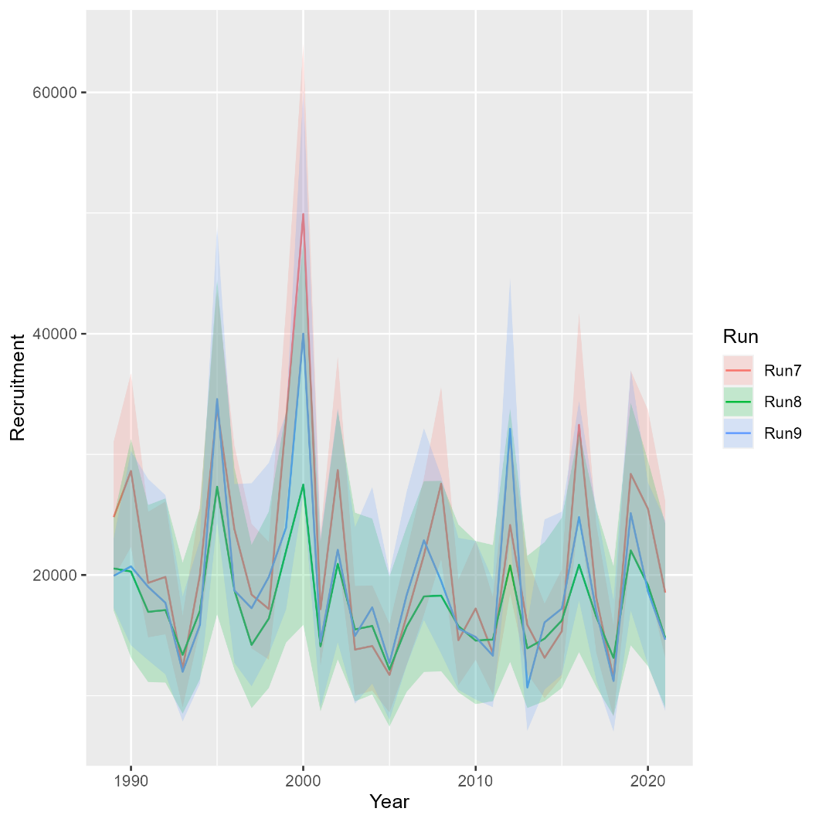
Runs 8-9: Exploring movement
Mohn’s rho
 | Fmort | SSB | Rect
Run7 | 0.178 | -0.073 | 0.029
Run8 | 0.13 | -0.03 | 0.034
Run9 | 0.157 | -0.066 | 0.019
South

Slide 8
OSA Residuals: Run 7 versus Run 8

Slide 9
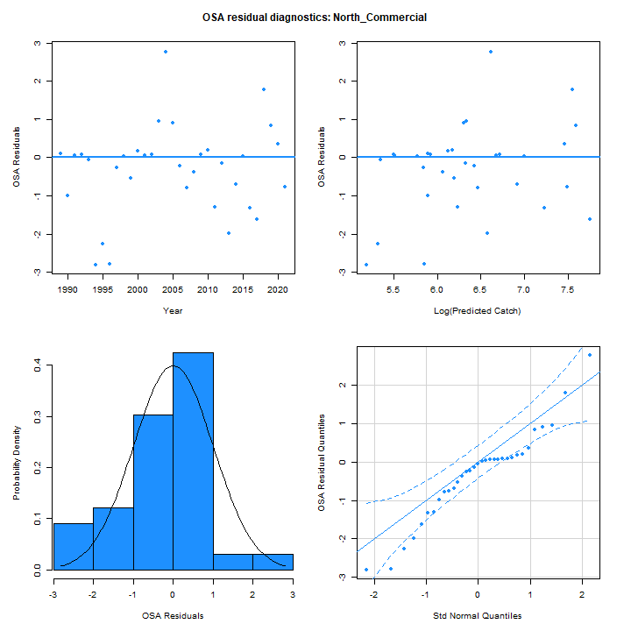
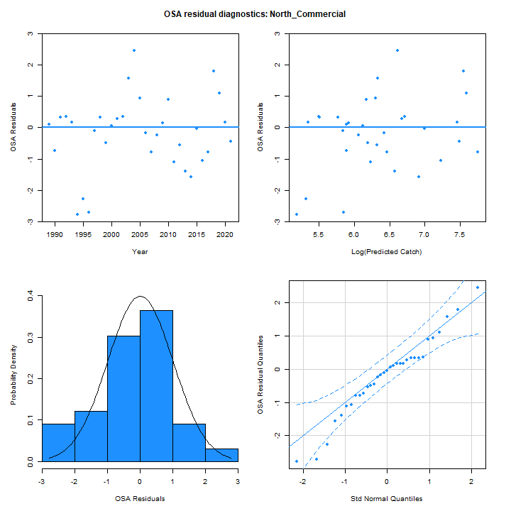
OSA Residuals
Run 7
Run 8

Slide 10
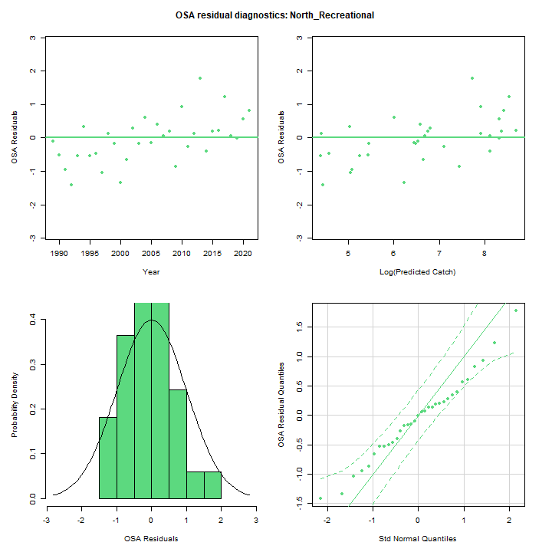
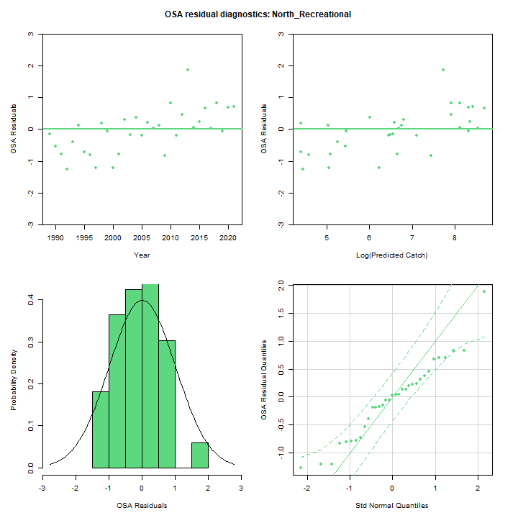
OSA Residuals
Run 7
Run 8

Slide 11
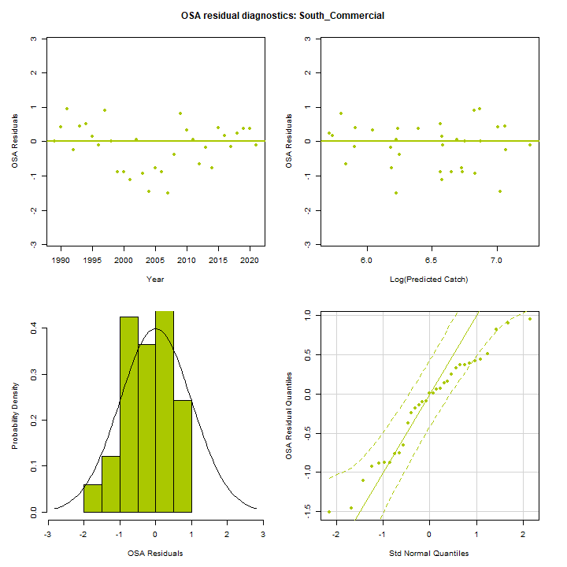
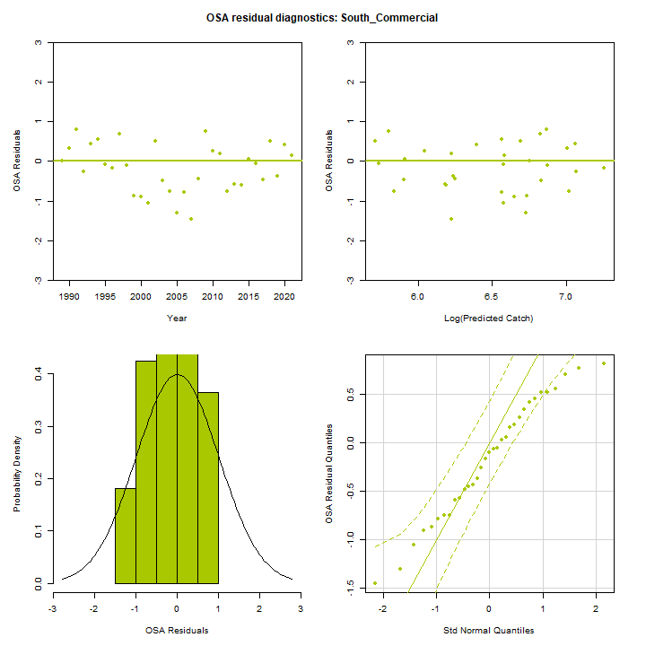
OSA Residuals
Run 7
Run 8

Slide 12
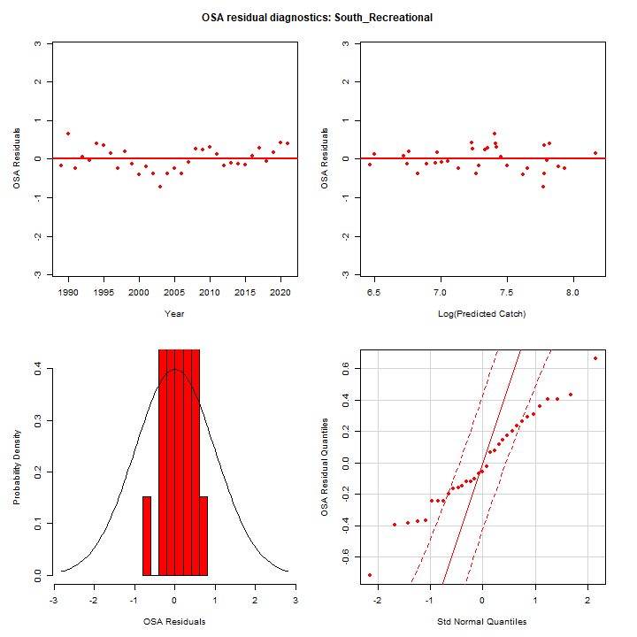
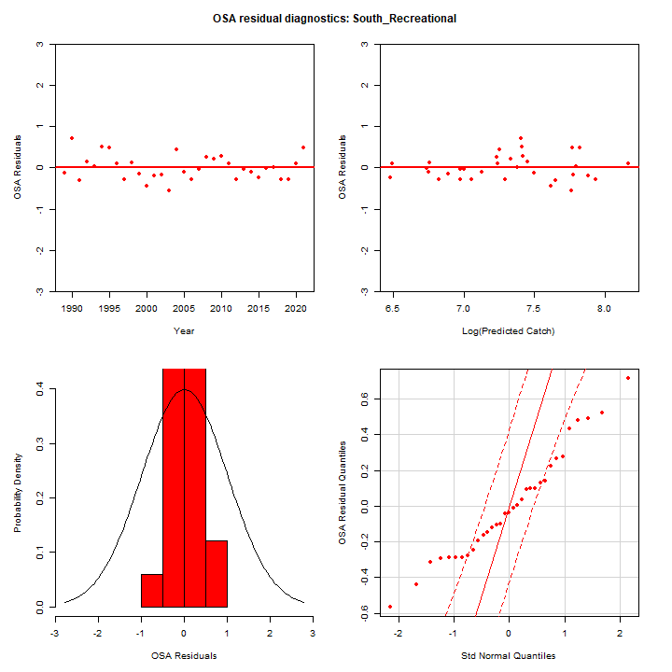
OSA Residuals
Run 7
Run 8

Slide 13
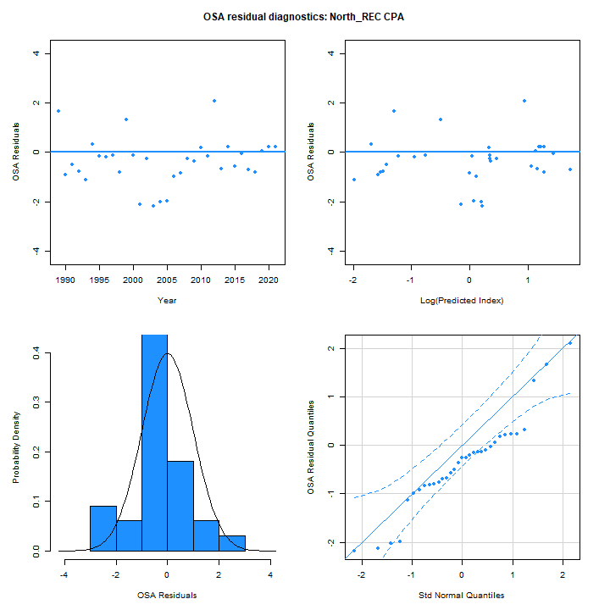

OSA Residuals
Run 7
Run 8

Slide 14
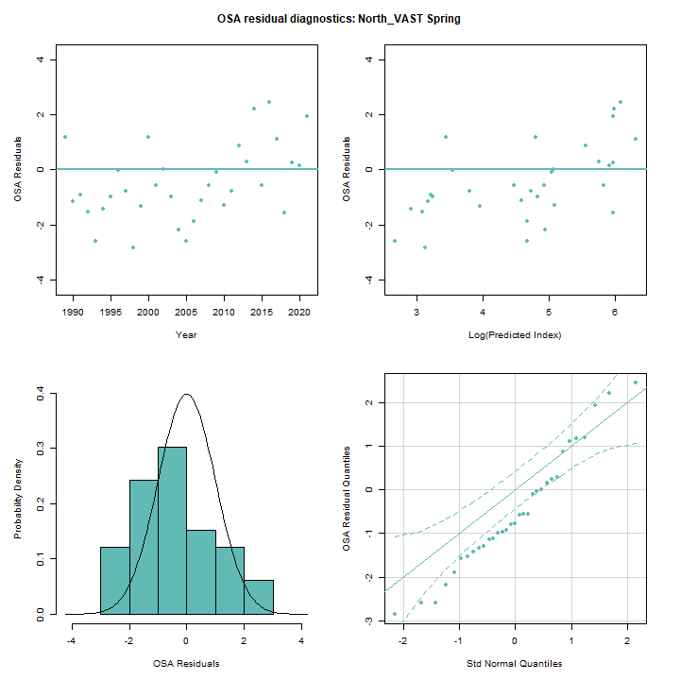
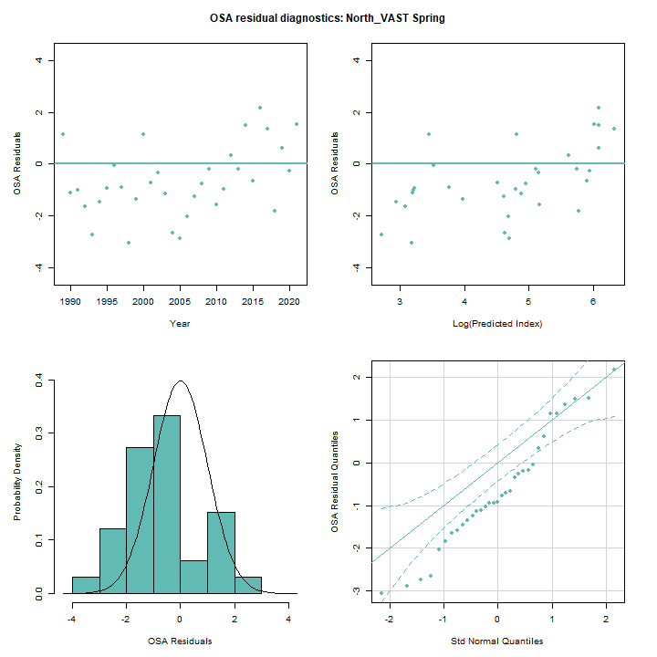
OSA Residuals
Run 7
Run 8

Slide 15
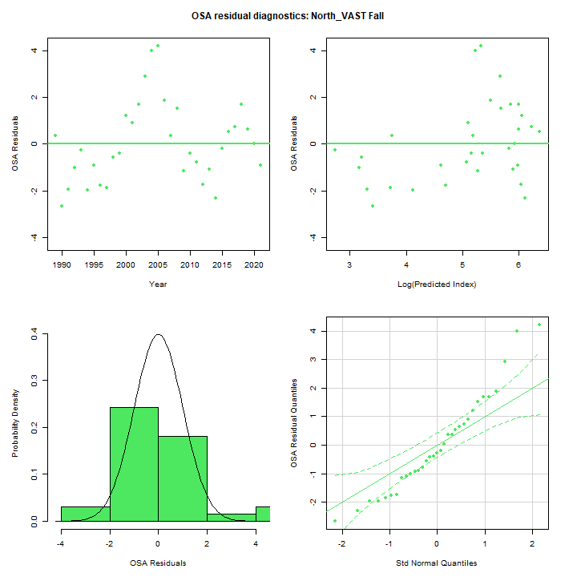
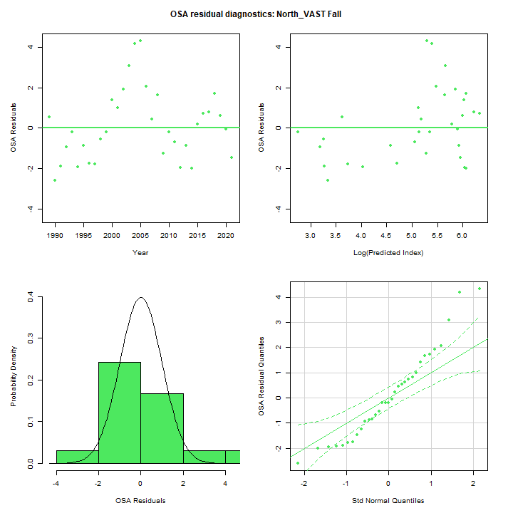
OSA Residuals
Run 7
Run 8

Slide 16
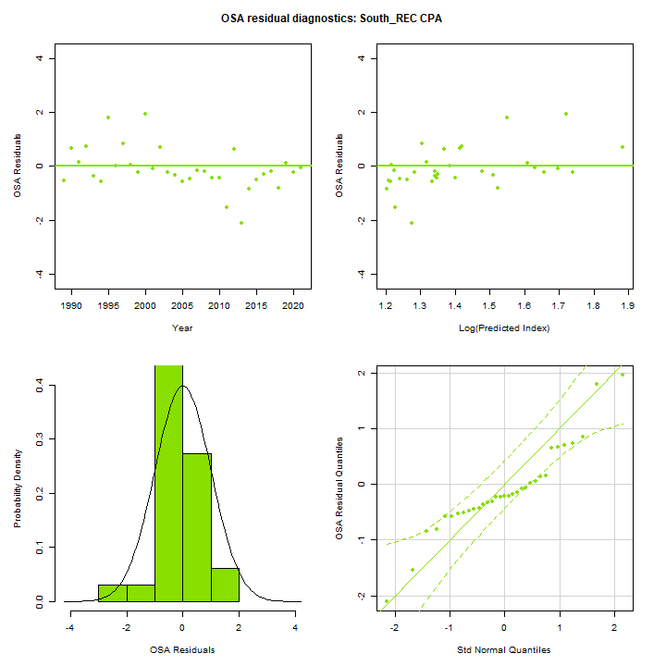
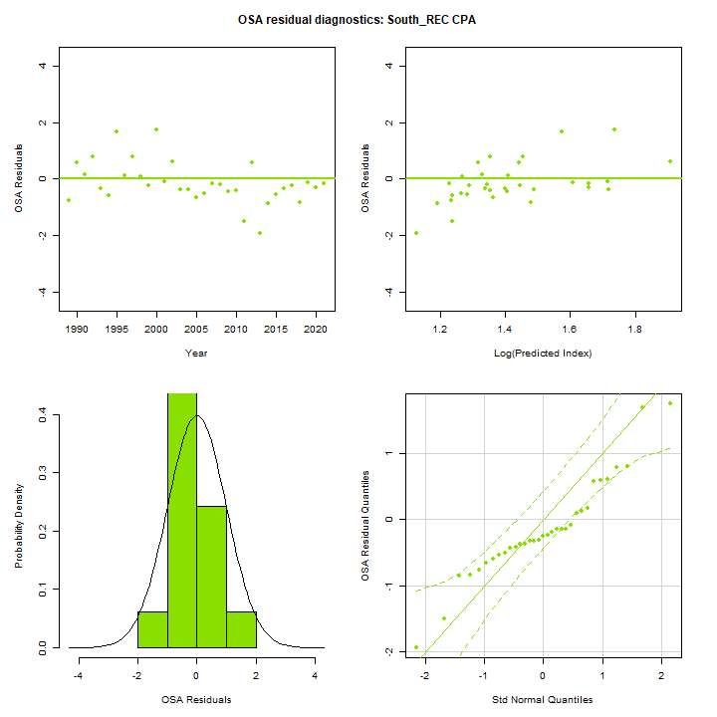
OSA Residuals
Run 7
Run 8

Slide 17
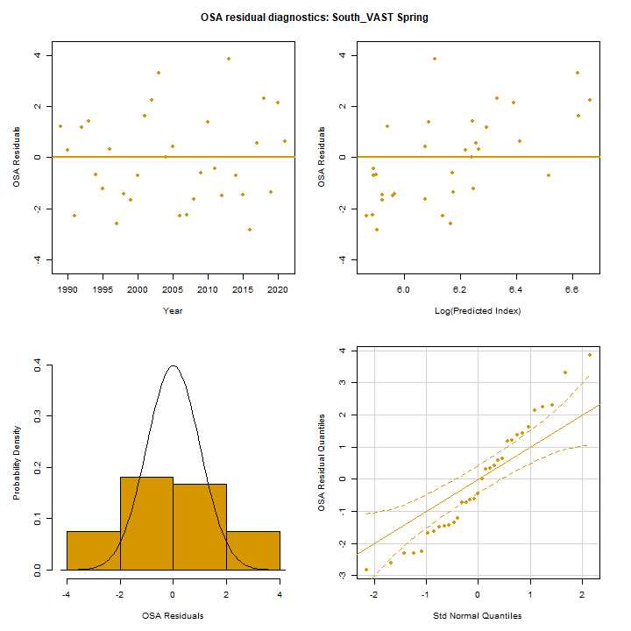
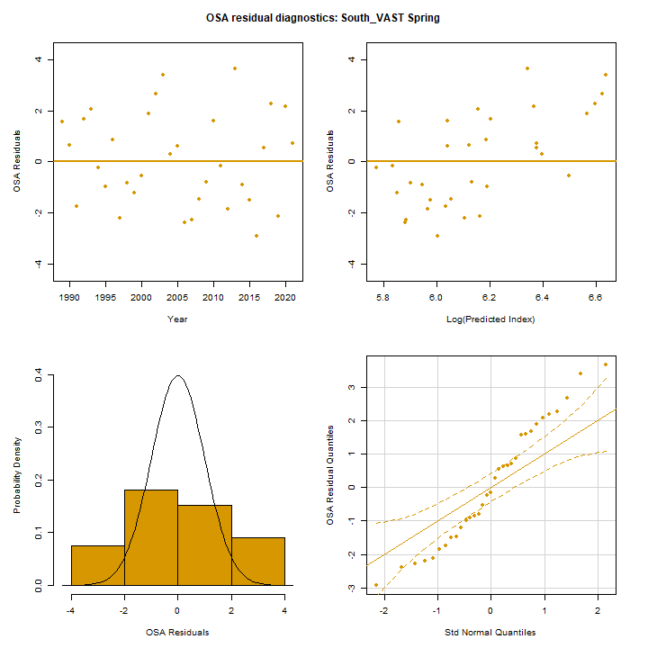
OSA Residuals
Run 7
Run 8

Slide 18
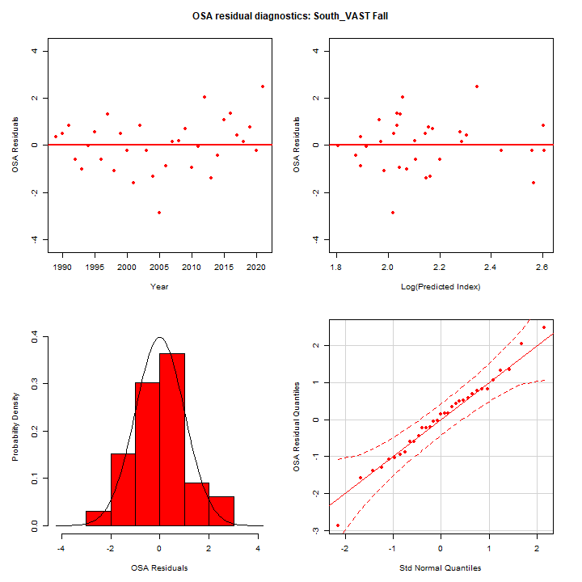
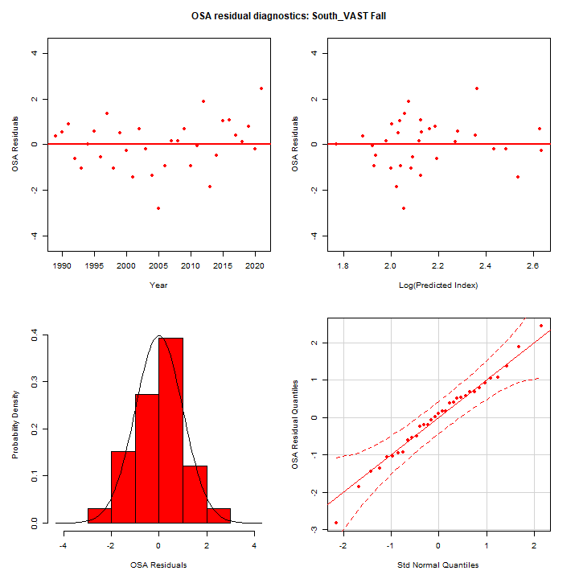
OSA Residuals
Run 7
Run 8

Slide 19
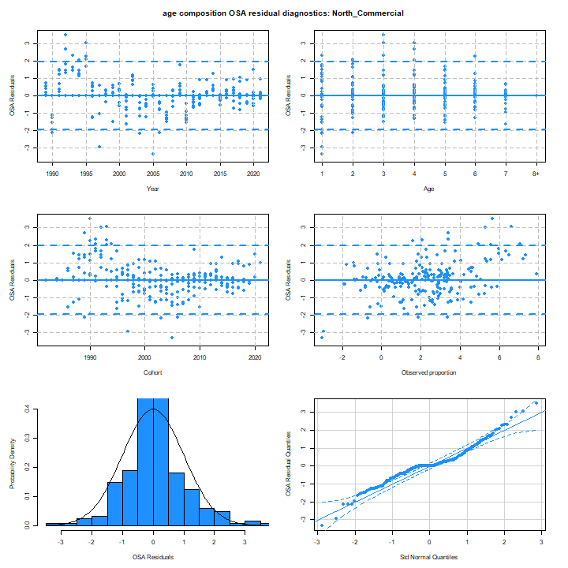

OSA Residuals
Run 7
Run 8

Slide 20
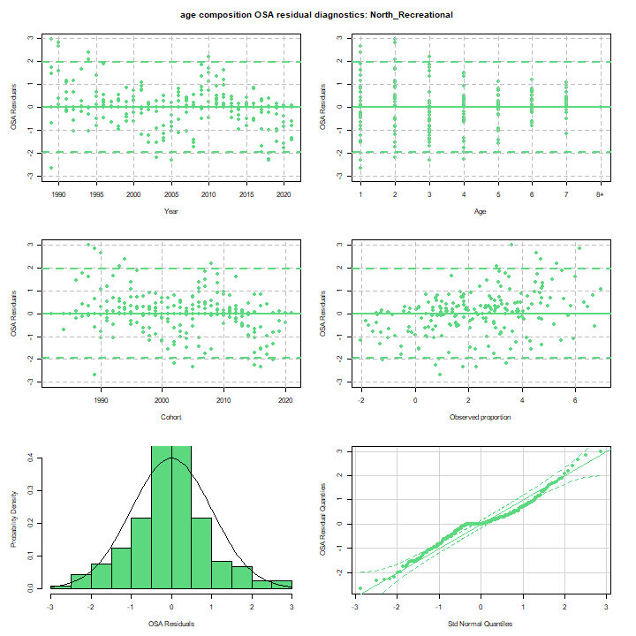
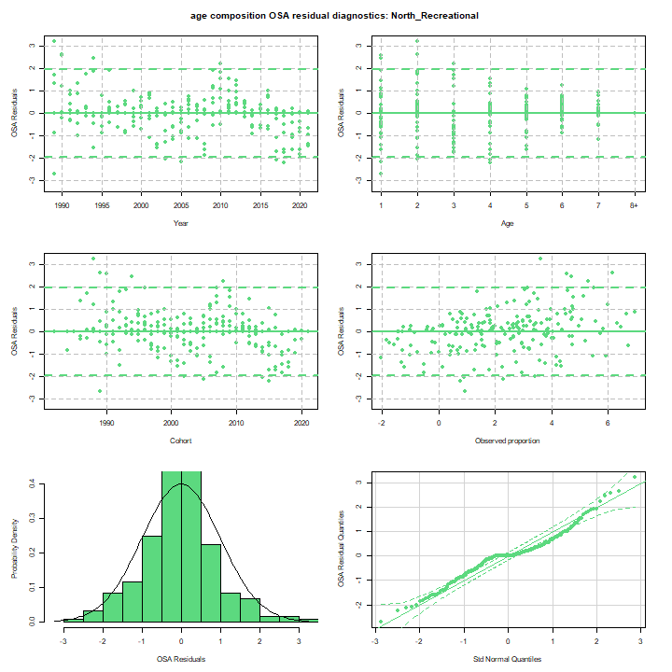
OSA Residuals
Run 7
Run 8

Slide 21
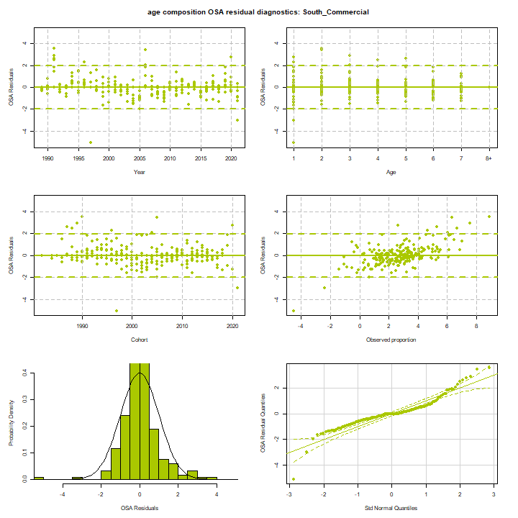
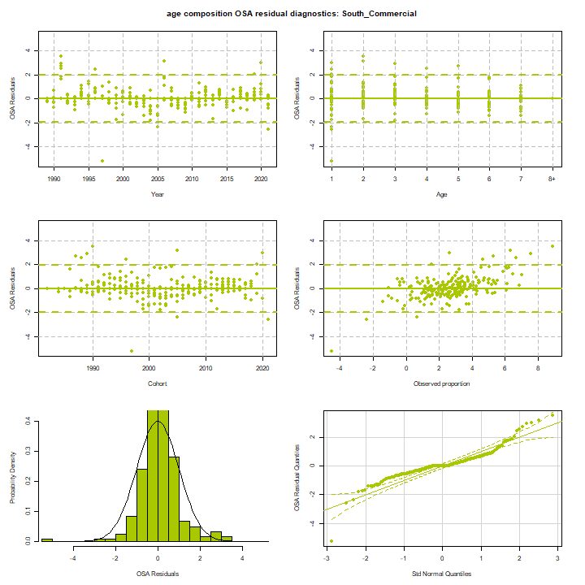
OSA Residuals
Run 7
Run 8

Slide 22
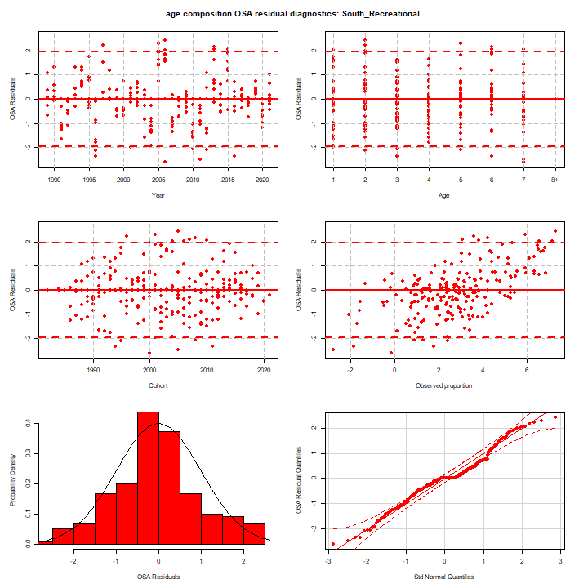

OSA Residuals
Run 7
Run 8

Slide 23
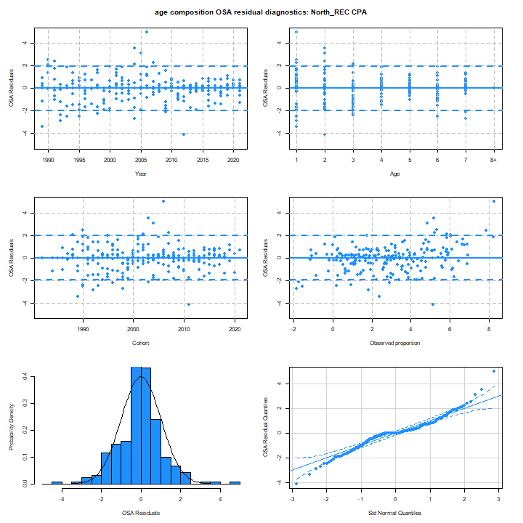
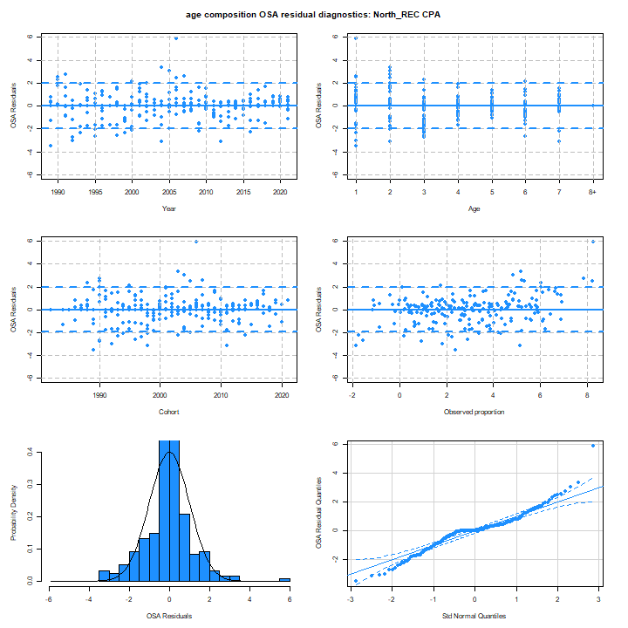
OSA Residuals
Run 7
Run 8

Slide 24


OSA Residuals
Run 7
Run 8

Slide 25
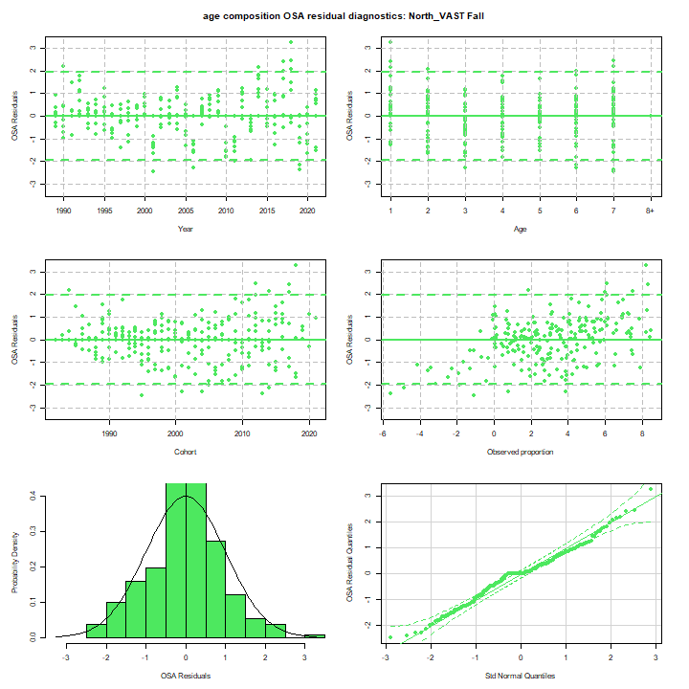
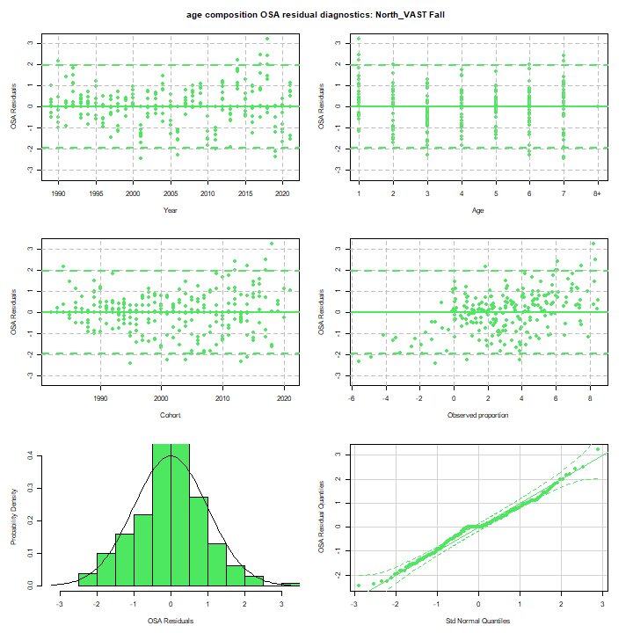
OSA Residuals
Run 7
Run 8

Slide 26
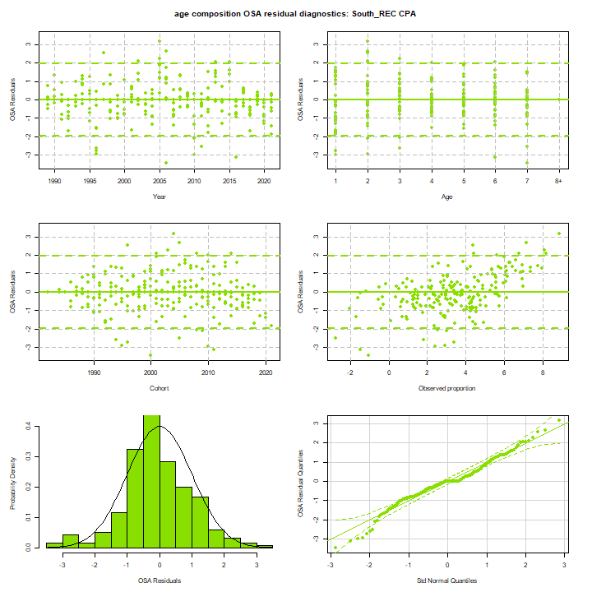

OSA Residuals
Run 7
Run 8

Slide 27
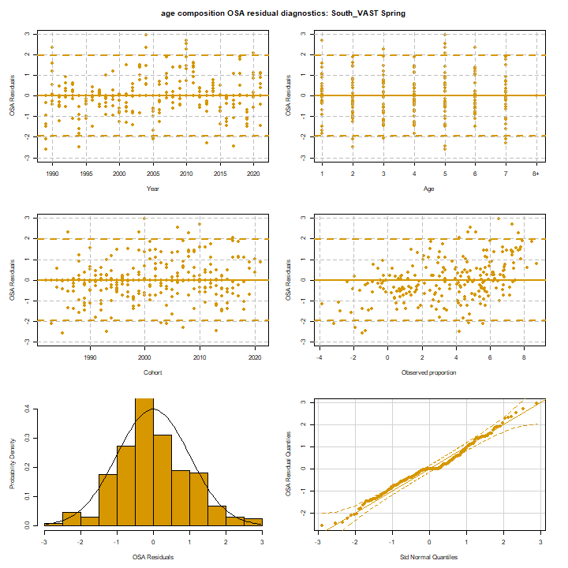
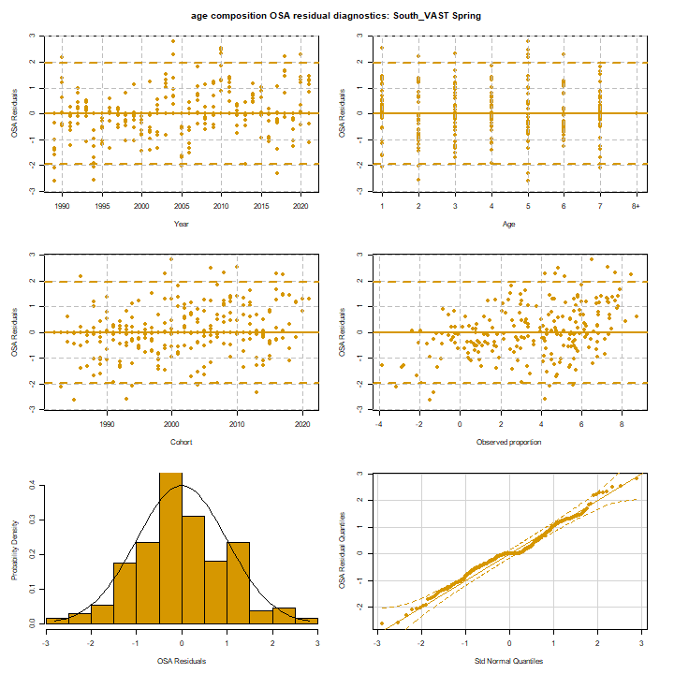
OSA Residuals
Run 7
Run 8

Slide 28
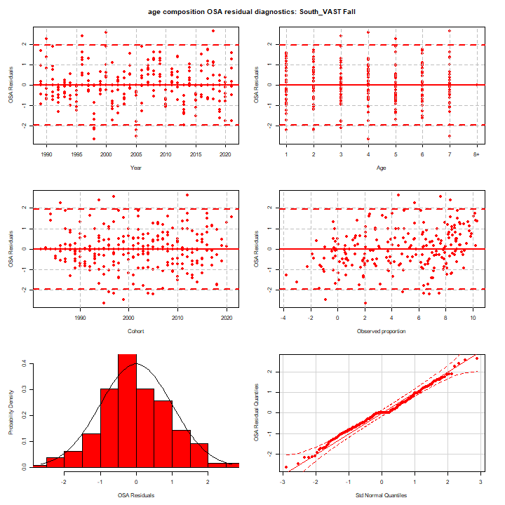
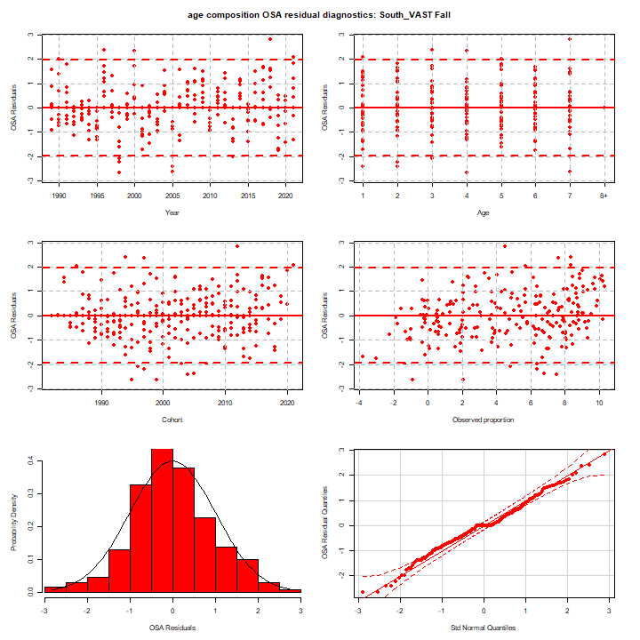
OSA Residuals
Run 7
Run 8

Slide 29
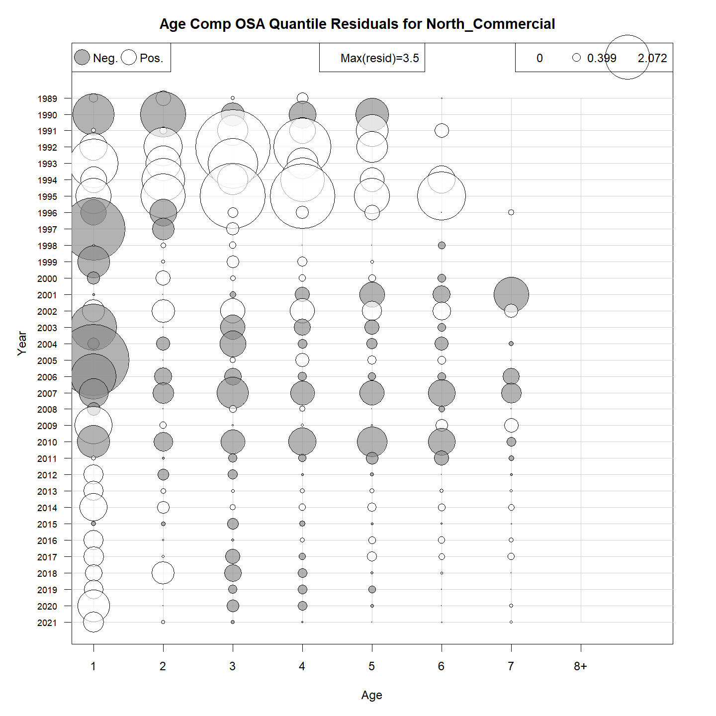
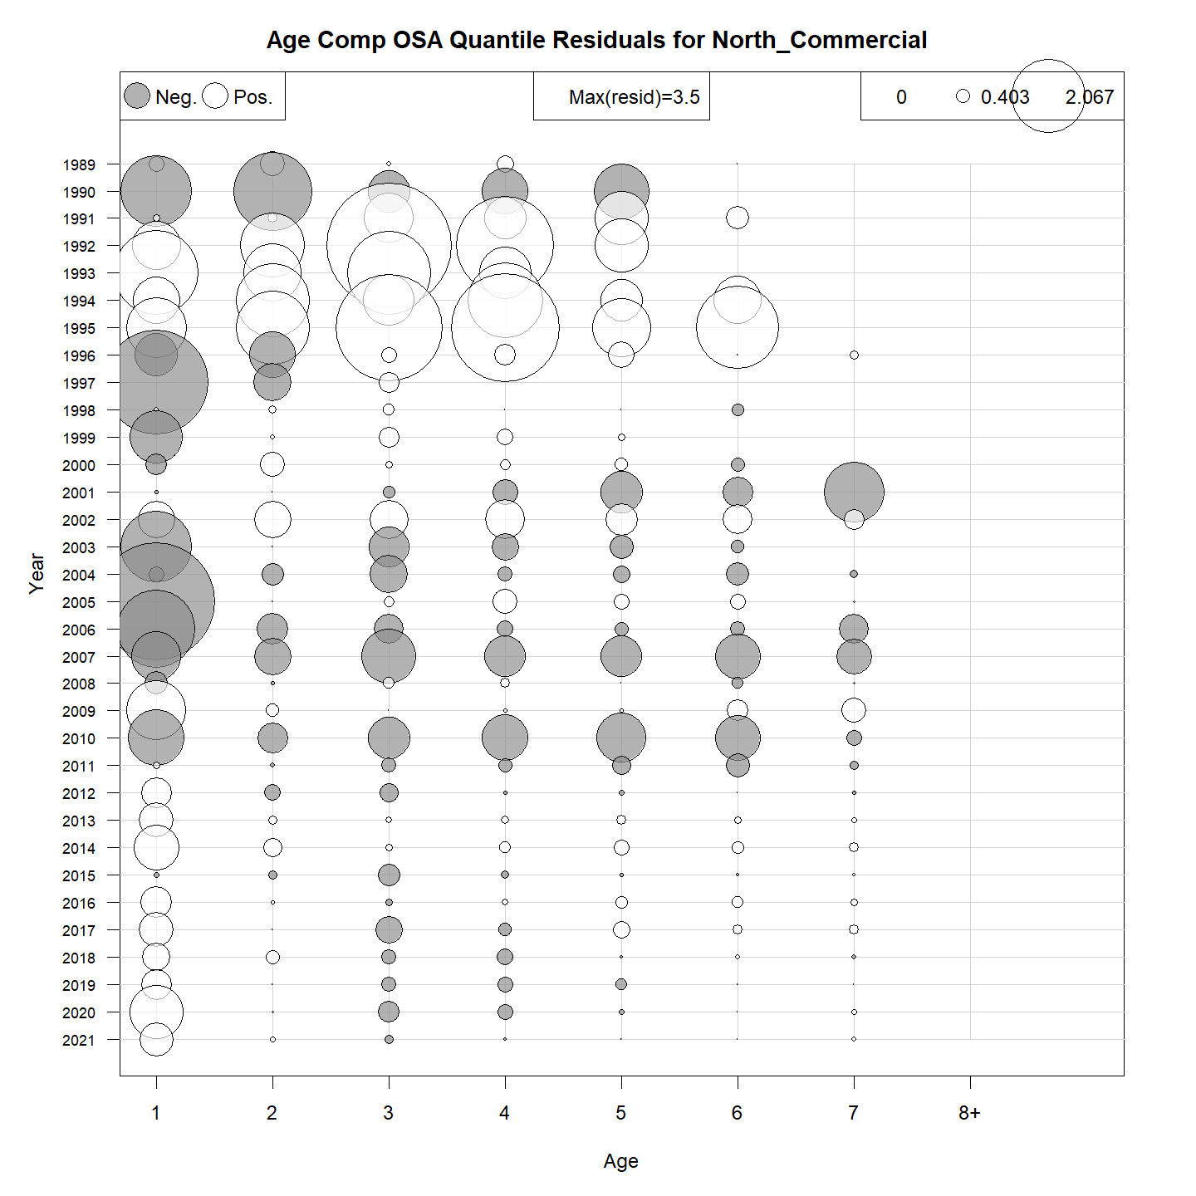
OSA Residuals
Run 7
Run 8

Slide 30
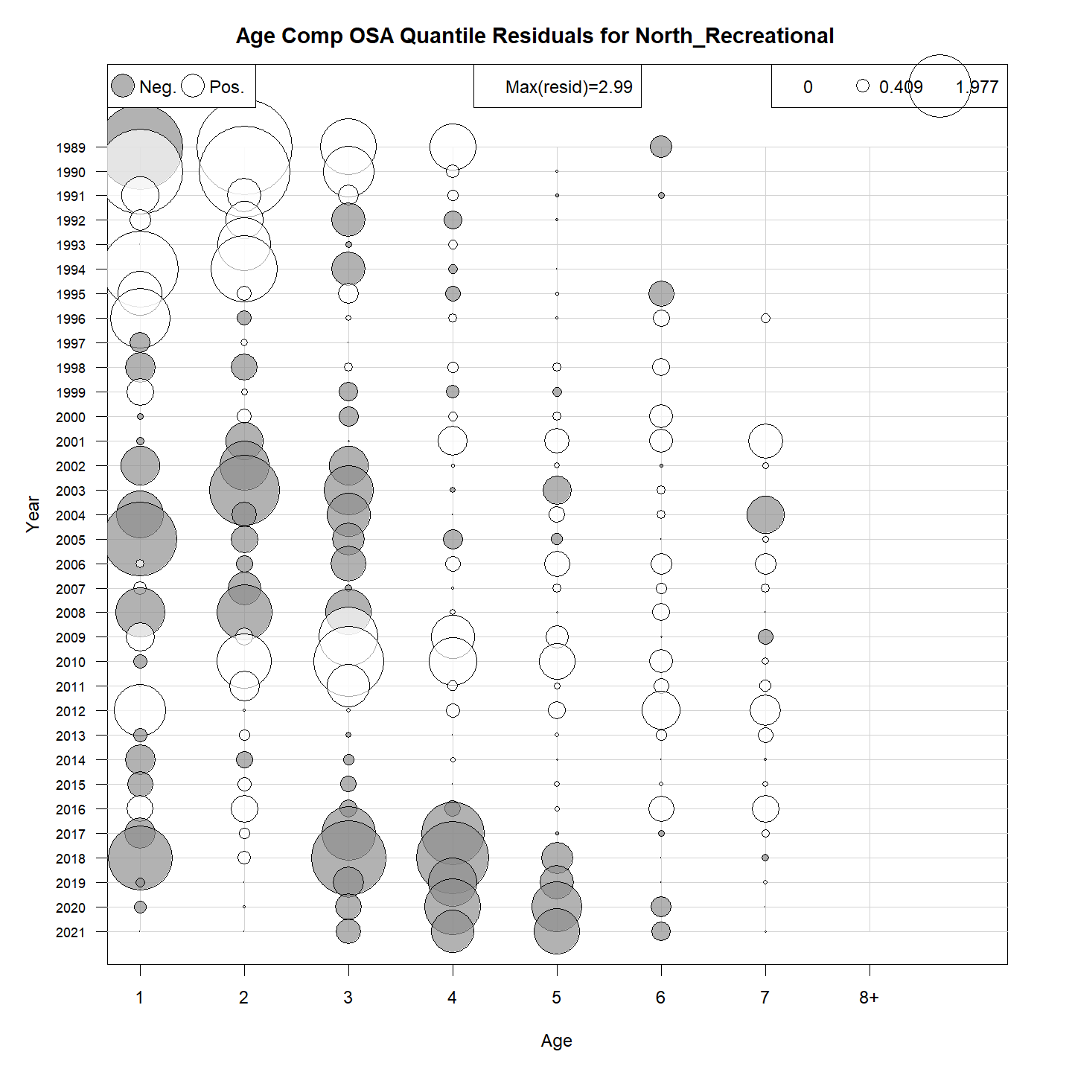
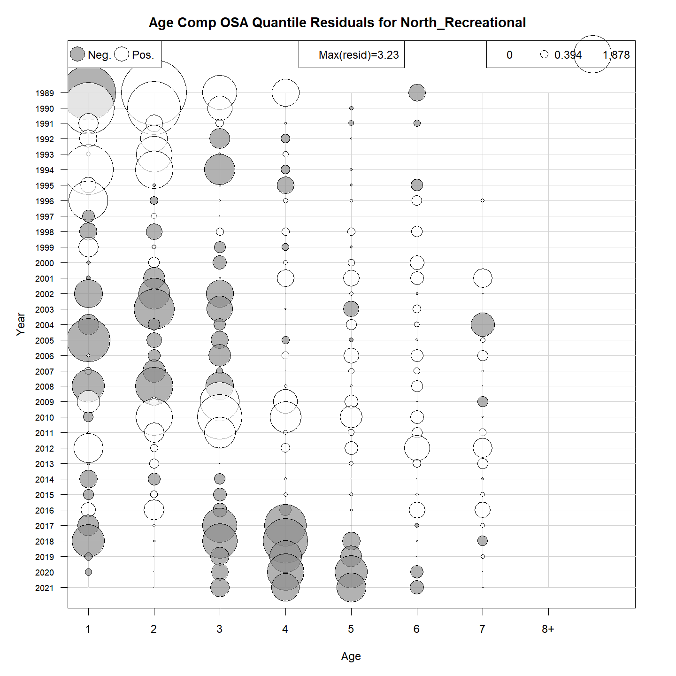
OSA Residuals
Run 7
Run 8

Slide 31


OSA Residuals
Run 7
Run 8

Slide 32


OSA Residuals
Run 7
Run 8

Slide 33


OSA Residuals
Run 7
Run 8

Slide 34


OSA Residuals
Run 7
Run 8

Slide 35


OSA Residuals
Run 7
Run 8

Slide 36


OSA Residuals
Run 7
Run 8

Slide 37


OSA Residuals
Run 7
Run 8

Slide 38


OSA Residuals
Run 7
Run 8

Slide 39
OSA Residuals: Run 8 versus Run 9

Slide 40

OSA Residuals
Run 8
Run 9

Slide 41

OSA Residuals
Run 8
Run 9

Slide 42

OSA Residuals
Run 8
Run 9

Slide 43

OSA Residuals
Run 8
Run 9

Slide 44

OSA Residuals
Run 8
Run 9

Slide 45

OSA Residuals
Run 8
Run 9

Slide 46

OSA Residuals
Run 8
Run 9

Slide 47

OSA Residuals
Run 8
Run 9

Slide 48

OSA Residuals
Run 8
Run 9

Slide 49

OSA Residuals
Run 8
Run 9

Slide 50

OSA Residuals
Run 8
Run 9

Slide 51

OSA Residuals
Run 8
Run 9

Slide 52

OSA Residuals
Run 8
Run 9

Slide 53

OSA Residuals
Run 8
Run 9

Slide 54

OSA Residuals
Run 8
Run 9

Slide 55

OSA Residuals
Run 8
Run 9

Slide 56

OSA Residuals
Run 8
Run 9

Slide 57

OSA Residuals
Run 8
Run 9

Slide 58

OSA Residuals
Run 8
Run 9

Slide 59

OSA Residuals
Run 8
Run 9

Slide 60

OSA Residuals
Run 8
Run 9

Slide 61

OSA Residuals
Run 8
Run 9

Slide 62

OSA Residuals
Run 8
Run 9

Slide 63

OSA Residuals
Run 8
Run 9

Slide 64

OSA Residuals
Run 8
Run 9

Slide 65

OSA Residuals
Run 8
Run 9

Slide 66

OSA Residuals
Run 8
Run 9

Slide 67

OSA Residuals
Run 8
Run 9

Slide 68

OSA Residuals
Run 8
Run 9

Slide 69

OSA Residuals
Run 8
Run 9

